Slide 1


NETFLIX RECOMMENDATION SYSTEM
Capstone Project
By :Mercy Subramani
Semester : Spring2023
Instructor : Dr. Chaojie Wang

Slide 2

Project Process flow diagram
Dataset from Data.World
Cleaning and Exploratory Data
Analysis
Data Preprocessing
Collaborative Filtering
Deployment
Model Evaluation
Data Modeling
Sentiment analysis on reviews

Slide 3
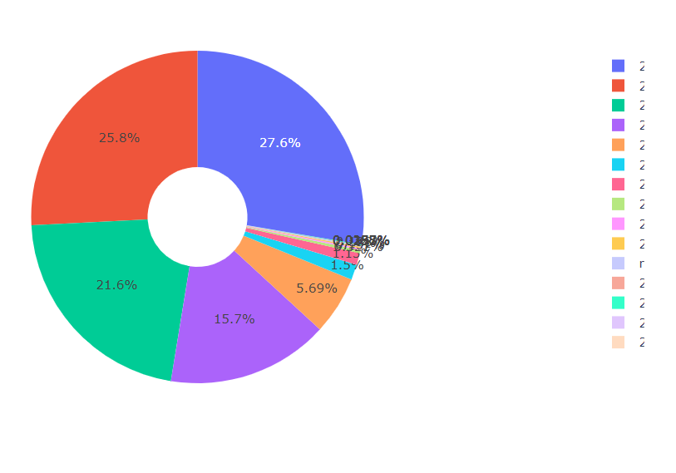
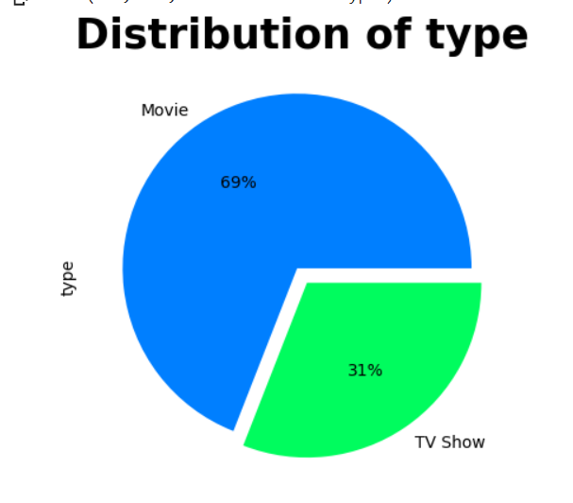
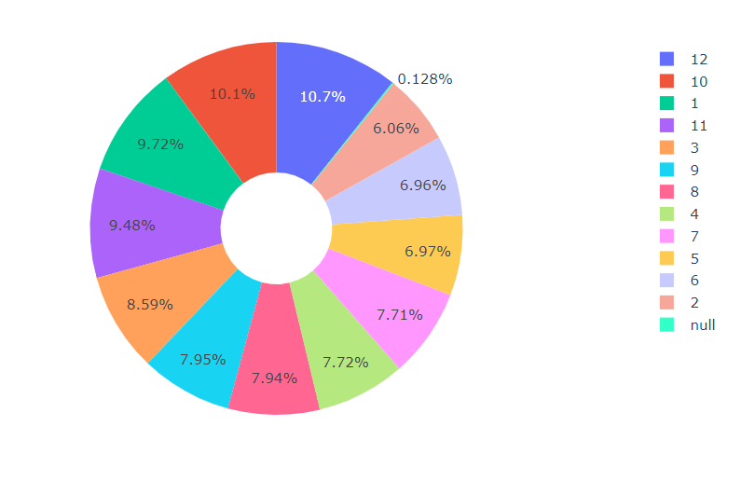
Exploratory Data analysis
Movie vs Tv show
Yearly Distribution
Monthly Distribution

Slide 4
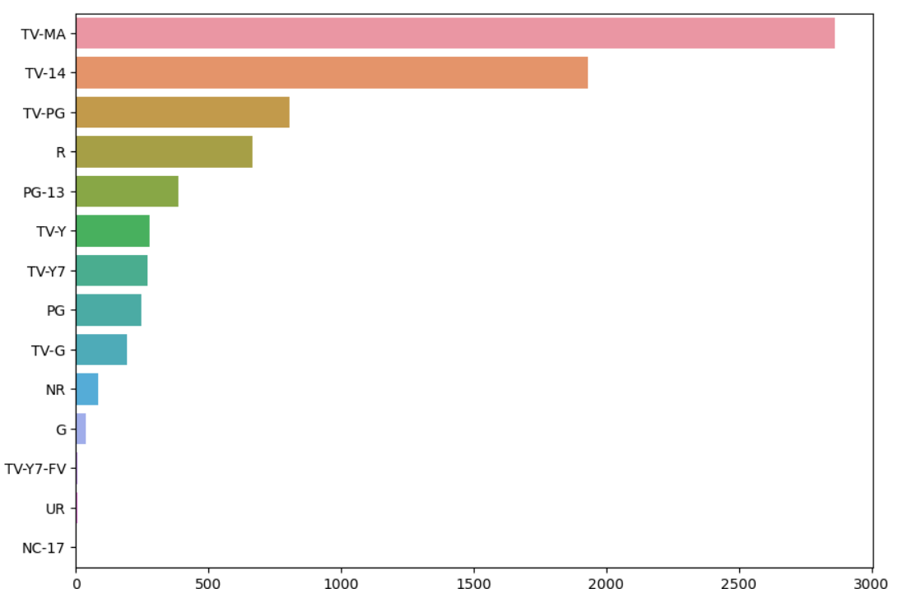
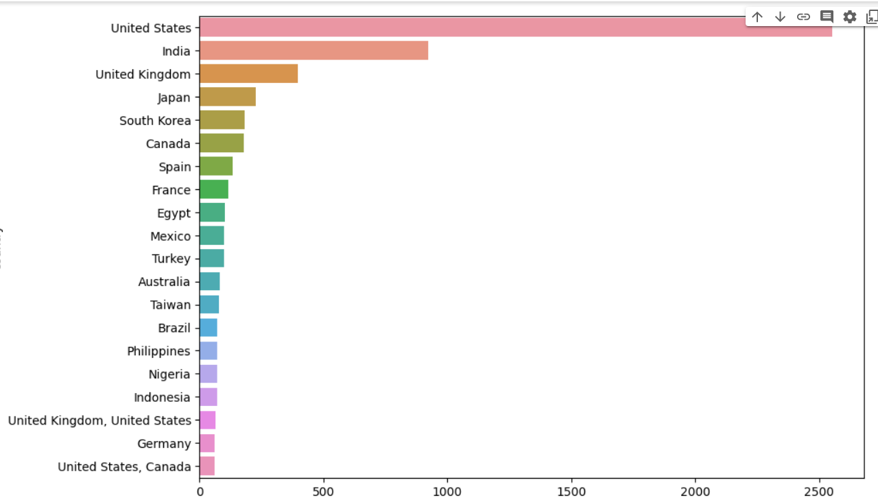
EDA continuation
Visualization shows that United states has more movies and tv shows than other countries
Next comes India and United Kingdom which have more movies in Netflix
Graph shows that Adult movies and Tv shows are more

Slide 5
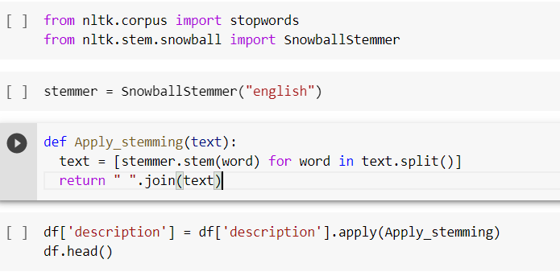
Data Preprocessing
Stemming
Used reduce words to its base
For example: “running” – “runs”
Application- search engines, text classification,
Sentiment analysis
Count Vectorization
Text preprocessing technique
Convert collection of text documents into
Numerical representation

Slide 6
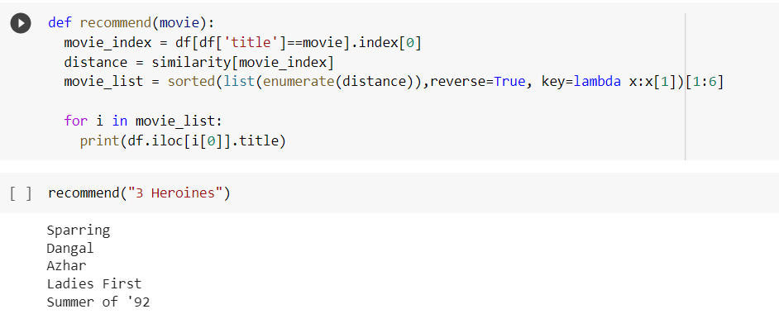
Cosine similarity
Measures similarity between two non-zero vectors
Here, cosine similarity is used to calculate items or
user based feature vectors
recommends similar items
It is dot product-based algorithm

Slide 7
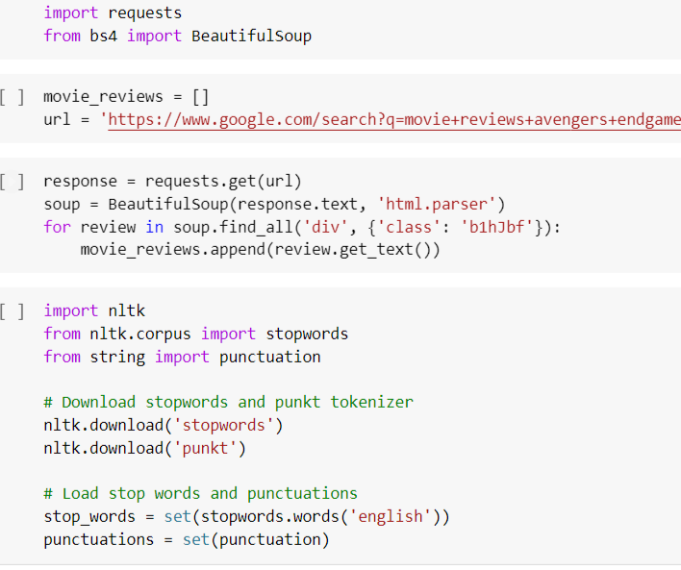
Web scraping
Web scraping was done by beautifulsoup
For example, I have taken avengers end game
Reviews
And used nlp based libraries like
stopwords, punctuation to clean data

Slide 8
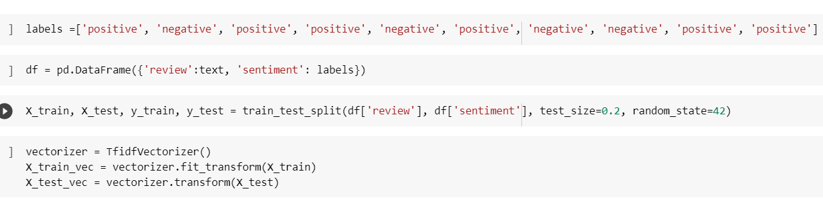
Sentiment Analysis
Sentiment Analysis was performed on reviews
It will help to recommend the similar movie with similar sentiments
-1 is Negative
+1 is Positive

Slide 9
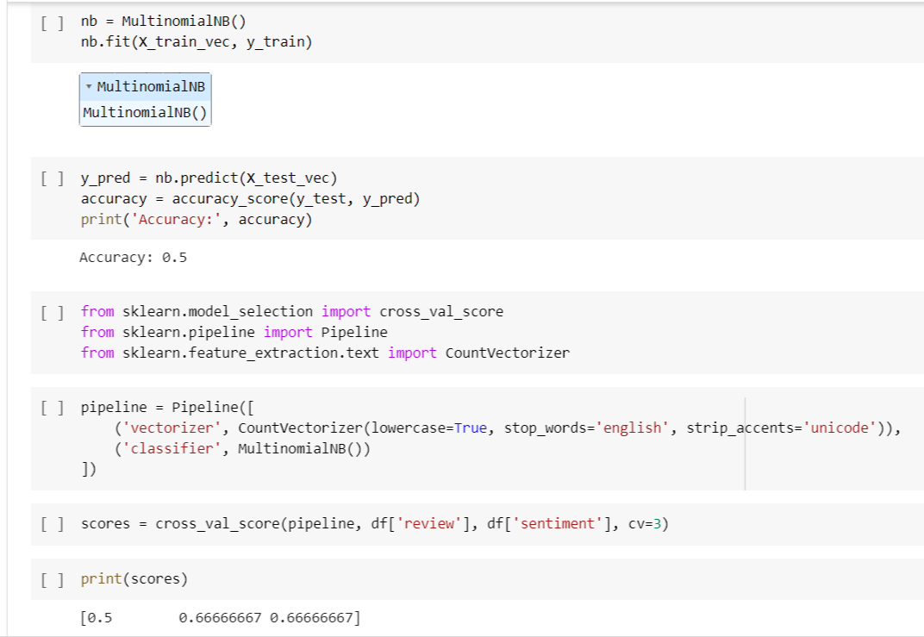
Data Modeling: naïve bayes
Naïve bayes was used on test and train data
It is a probabilistic classification algorithm
Used for classification task , sentiment analysis
and spam filtering
It makes the assumption that all features are
independent of each other

Slide 10
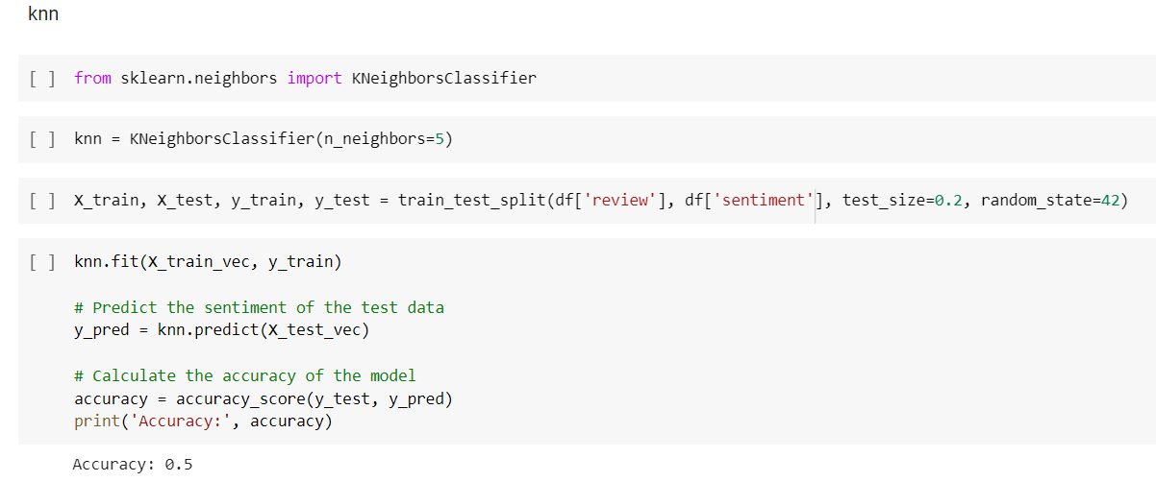
K Nearest Neighbors
K Nearest Neighbors is also used to check the accuracy
It is a clustering algorithm
It is a hyperparameter that can adjust based on problems

Slide 11
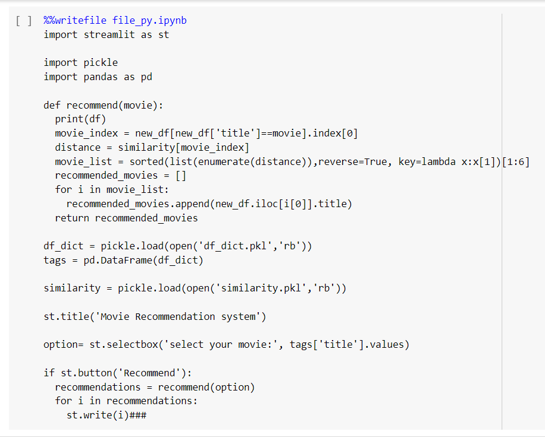
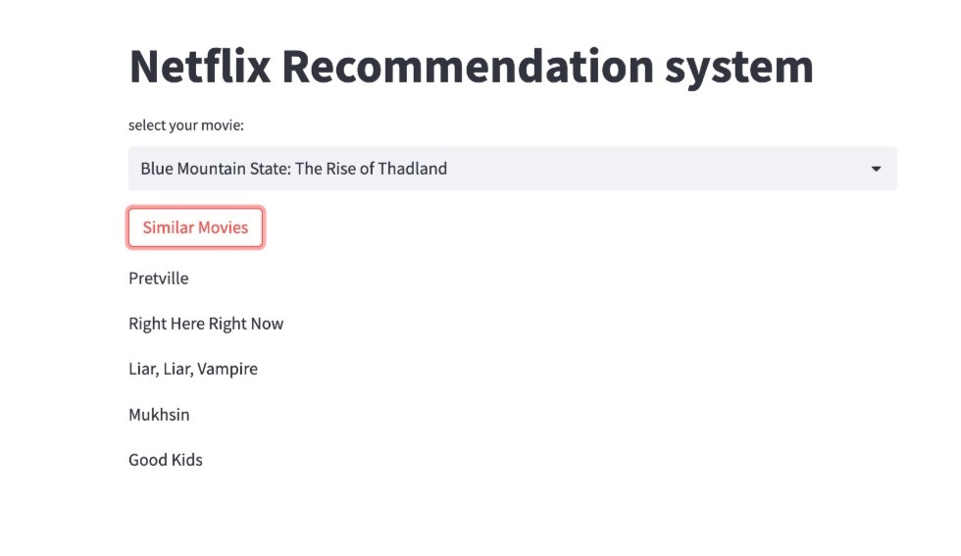
Deployment
Deployed using Streamlit
User friendly interface
No HTML , CSS is needed
Based on python language

Slide 12


